Slide 1
Chapter 06

Slide 2
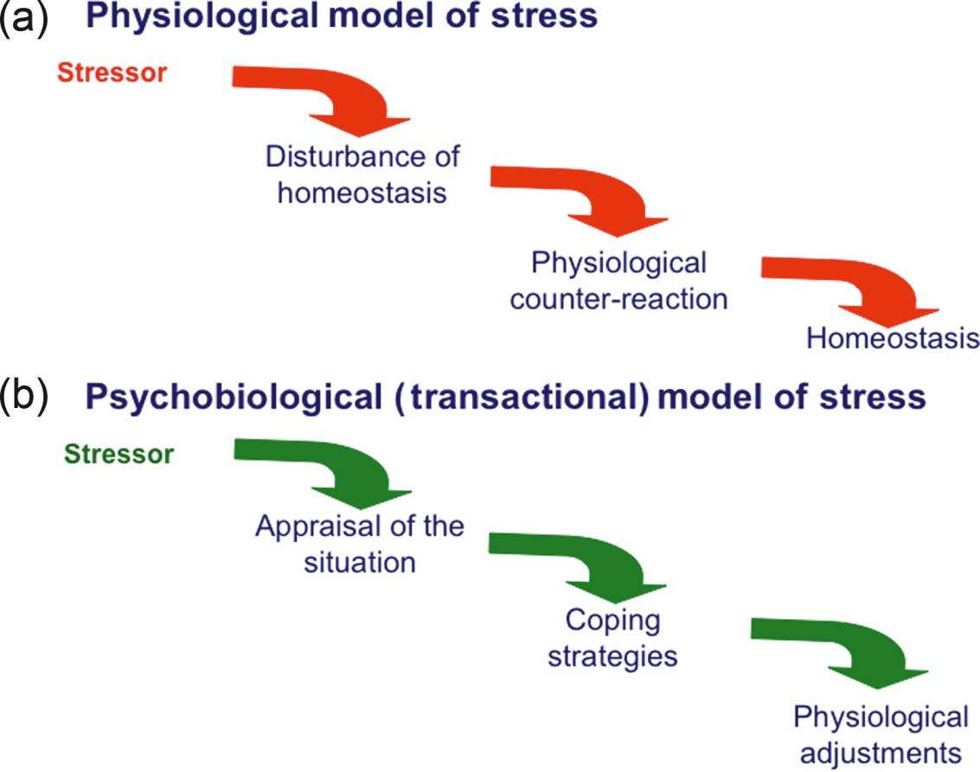
Figure 1 Differences between the homeostatic and transactional models of stress. (a) In the homeostatic model of stress, the behavioral response to stress is reflex-like and is a necessary conduit for reestablishment of homeostasis. (b) In the transactional model of stress, behavioral adjustments take place in response to cognitive and emotional appraisal of the situation. They allow the subjects to cope with the stress situation, which ultimately results in decreases in physiological arousal.

Slide 3
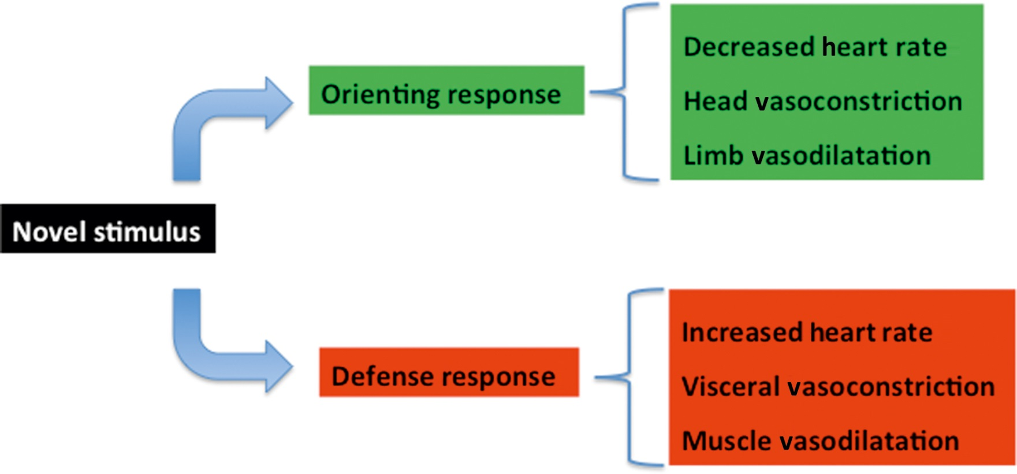
Figure 2 Coupling of behavioral responses to novelty with physiology. Exposure to novelty can lead to orienting or defense responses, with different physiological correlates. An orienting response usually develops in response to a mildly novel stimulus that occurs in familiar surroundings. A defense response typically develops in response to a sudden novel stimulus especially when it occurs in unfamiliar surroundings. The exact nature of the relationship between the physiological signature of the behavioral response to novelty that was initially described by Sokolov⁷ and the ability to process environmental stimuli was the object of heated disputes between Lacey and Obrist. Lacey made the physiological response a necessary condition for the ability of the cortex to process novel information⁸ whereas Obrist saw it as a simple correlate of the somatic component of the behavioral response to novelty.⁹

Slide 4
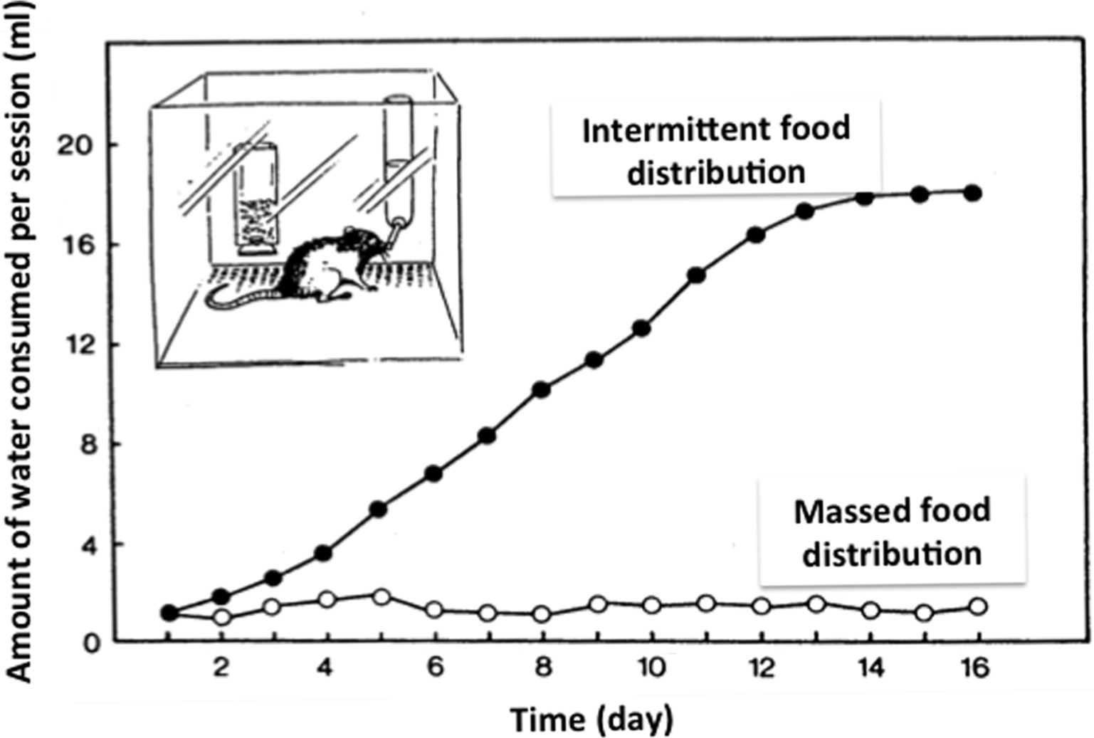
Figure 3 Development of schedule-induced polydipsia in rats submitted to an intermittent schedule of food reinforcement. Rats maintained at approximately 80% of their free feeding body weight were placed daily in a Skinner box in which they received a food pellet every minute during a 30 min session. They had free access to a tube connected to a water bottle. Control rats received the same amount of food but in one distribution at the beginning of the session. Note that excessive drinking (polydipsia) developed only in rats submitted to the intermittent delivery of food.
Modified from Ref. 19.

Slide 5
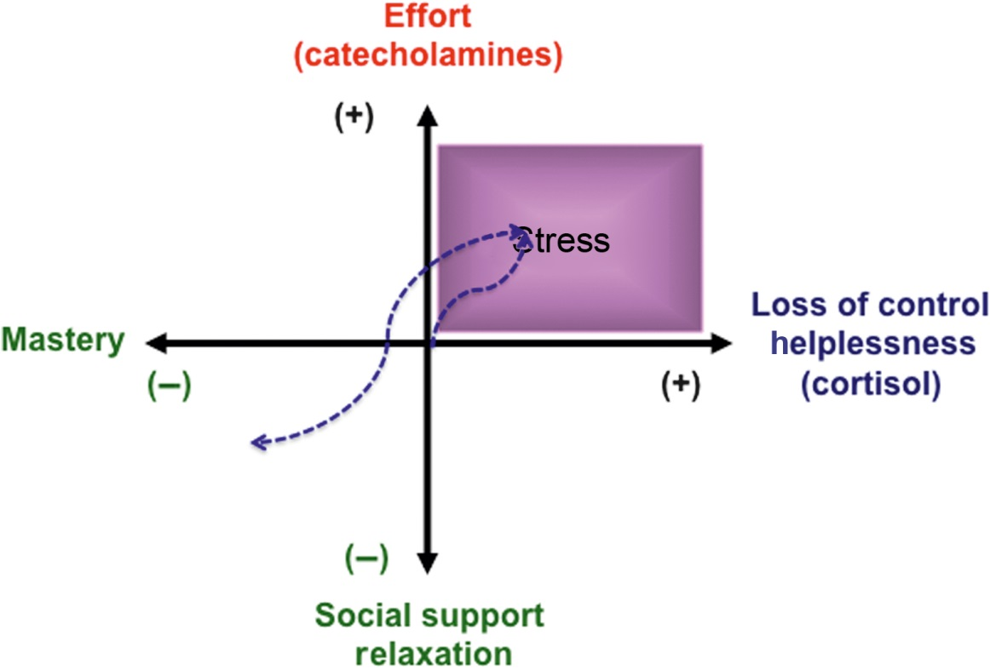
Figure 4 Bidirectional relationships between coping strategies and stress hormonal responses. Each axis represents a behavioral trajectory together with its neuroendocrine correlates. The diagram contrasts trajectories on the effort/relaxation axis associated with activation of the sympathetic nervous system and the adrenal medulla to trajectories on the loss of control/mastery axis associated with activation of the hypothalamic-pituitary-adrenal axis. The intersection of the two axes corresponds to the lack of challenge. In response to a stressful challenge, individuals will move toward the upper right of the diagram and lean toward the horizontal or the vertical axis depending on their fear of losing control and the amount of effort they need to deploy to control the situation. Mastering the situation will bring them to the left side of the diagram and even further down vertically if they obtain positive feedback on the success of their strategy and congratulations from their peers. The blue dotted line represents such a hypothetical trajectory. Note that the upper right quadrant corresponds to stress in its usual acceptation and that individuals with a higher than normal baseline neuroendocrine activity will not start their trajectory from the origin but from some position on the vertical or horizontal axis that corresponds to their hormonal status.
Adapted from Ref. 28.

